Slide 1
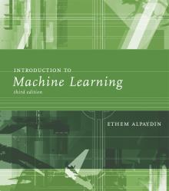
INTRODUCTION TO Machine Learning 3rd Edition
Lecture Slides for
ETHEM ALPAYDIN
© The MIT Press, 2014
alpaydin@boun.edu.tr
http://www.cmpe.boun.edu.tr/~ethem/i2ml3e

Slide 2
CHAPTER 2: Supervised Learning

Slide 3
Learning a Class from Examples
Class C of a “family car”
Prediction: Is car x a family car?
Knowledge extraction: What do people expect from a family car?
Output:
Positive (+) and negative (–) examples
Input representation:
x₁: price, x₂ : engine power

Slide 4
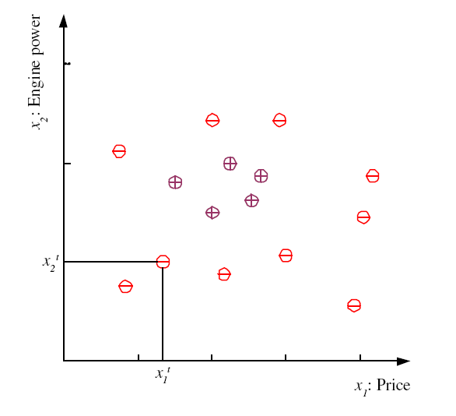
Training set X
One data example
Combining several examples is called Training Set
r is called label

Slide 5



Training set X
Training Set
N = total no. of examples
$$χ^{1}=\left\{x^{1},r^{1}\right\}=car1$$
$$χ^{2}=\left\{x^{2},r^{2}\right\}=car2$$
$$χ^{3}=\left\{x^{3},r^{2}\right\}=car3$$

Slide 6
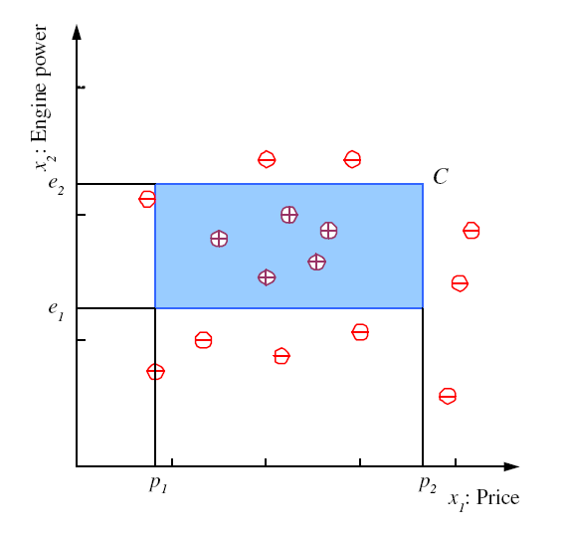
Class C
C is a class advised by experts or data analysis. In ML, we don’t know what C is

Slide 7
Hypothesis h
Let draw a hypothesis h i.e., a decision trying to separate positive and negative examples. It can be right or wrong.

Slide 8
Hypothesis h
Let draw a hypothesis h i.e., a decision trying to separate positive and negative examples. It can be right or wrong.

Slide 9
Hypothesis h
Let draw a hypothesis h i.e., a decision by ML trying to separate positive and negative examples. It can be right or wrong.

Slide 10

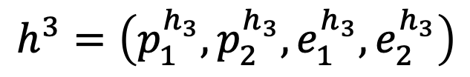
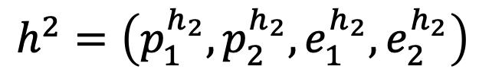
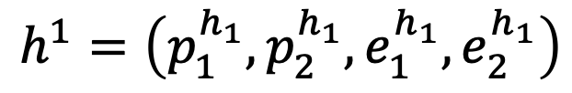
Hypothesis h
$$ℋ=\left\{h^{1},h^{2},h^{3},…\right\}$$
Set of hypothesis
$$h^{1}=\left(p_{1}^{h_{1}},p_{2}^{h_{1}},e_{1}^{h_{1}},e_{2}^{h_{1}}\right)$$
$$h^{2}=\left(p_{1}^{h_{2}},p_{2}^{h_{2}},e_{1}^{h_{2}},e_{2}^{h_{2}}\right)$$
$$h^{3}=\left(p_{1}^{h_{3}},p_{2}^{h_{3}},e_{1}^{h_{3}},e_{2}^{h_{3}}\right)$$

Slide 11
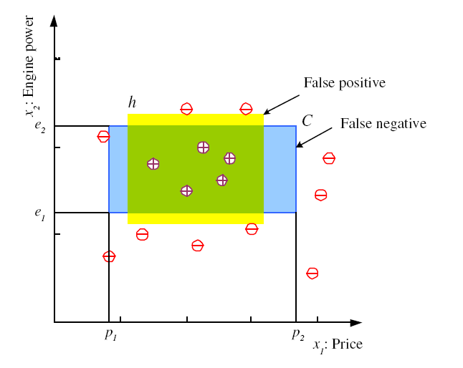
Error on H
Error of h on H

Slide 12
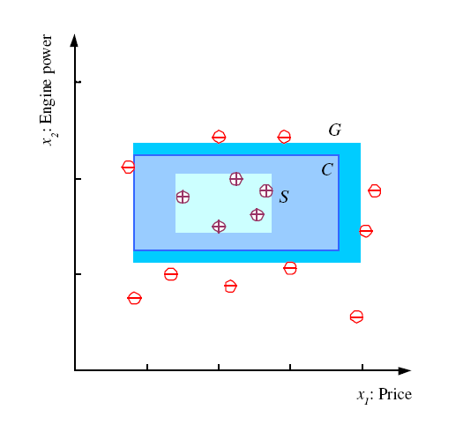
Specific, General, and the Version Space
most specific hypothesis, S
most general hypothesis, G
h ∈ H, between S and G is
consistent and make up the
version space
(Mitchell, 1997)

Slide 13
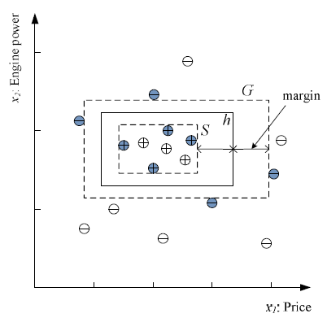
Margin
Choose h with largest margin

Slide 14
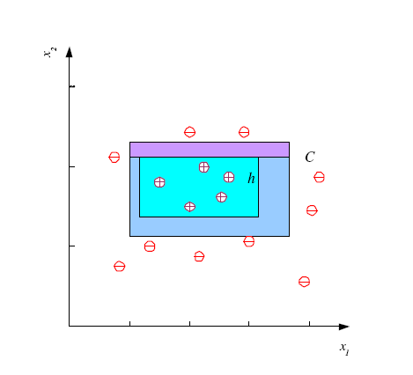
Probably Approximately Correct (PAC) Learning

Slide 15
Probably Approximately Correct (PAC) Learning
How many training examples N should we have, such that with probability at least 1 ‒ δ, h has error at most ε ?
δ ≤ 1/2 and ε > 0
Each strip is at most ε/4
Pr that we miss a strip 1‒ ε/4
Pr that N instances miss a strip (1 ‒ ε/4)^{N}
Pr that N instances miss 4 strips 4(1 ‒ ε/4)^{N}

Slide 16
Probably Approximately Correct (PAC) Learning
How many training examples N should we have, such that with probability at least 1 ‒ δ, h has error at most ε ?
4(1 ‒ ε/4)^{N} ≤ δ , solve for N
and N ≥ (4/ε)log(4/δ)

Slide 17
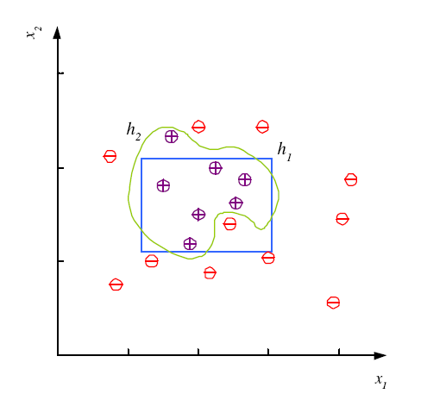
Noise and Model Complexity
Use the simpler one because
Simpler to use
(lower computational
complexity)
Easier to train (lower
space complexity)
Easier to explain
(more interpretable)
Generalizes better (lower
variance - Occam’s razor)

Slide 18
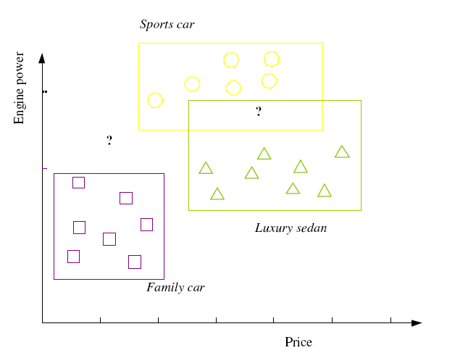

Multiple Classes, C_{i} i=1,...,K
Train hypotheses
h_{i}(x), i =1,...,K:

Slide 19
Multiple Classes, C_{i} i=1,...,K
Divide multi-class as multiple two-class problem

Slide 20
Multiple Classes, C_{i} i=1,...,K
Train hypotheses
h_{i}(x), i =1,...,K:

Slide 21
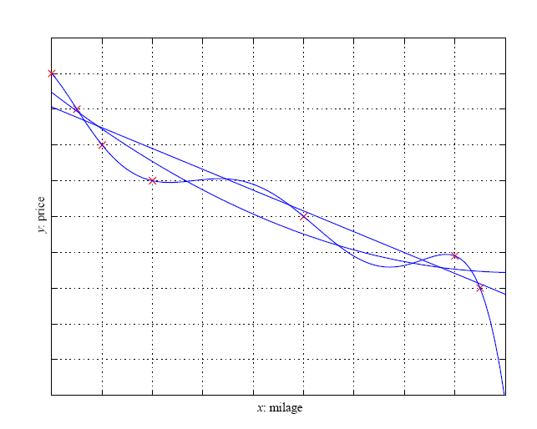
Regression

Slide 22
Model Selection & Generalization
Learning is an ill-posed problem; data is not sufficient to find a unique solution
Generalization: How well a model performs on new data
Overfitting: H more complex than C or f
Underfitting: H less complex than C or f

Slide 23
Triple Trade-Off
There is a trade-off between three factors (Dietterich, 2003):
Complexity of H is C(H),
Training set size, N,
Generalization error, E, on new data

Slide 24
Cross-Validation
To estimate generalization error, we need data unseen during training. We split the data as
Training set (50%)
Validation set (25%)
Test (publication) set (25%)
Resampling

Slide 25
Dimensions of a Supervised Learner
Model:
Loss function:
Optimization procedure:

Slide 26
Practice
Why it is better to use the average of S and G as final hypothesis?

Slide 27
Practice
Can we use a circle instead of a rectangle for our hypothesis? What should be the parameters? What if we use an ellipse?

Slide 28
Practice
In the regression problem, we choose error to be sum of squares of difference between label and model’s output. Can there be any other error function, what is the disadvantage of using sum of squares function? Any alternative?

Slide 29
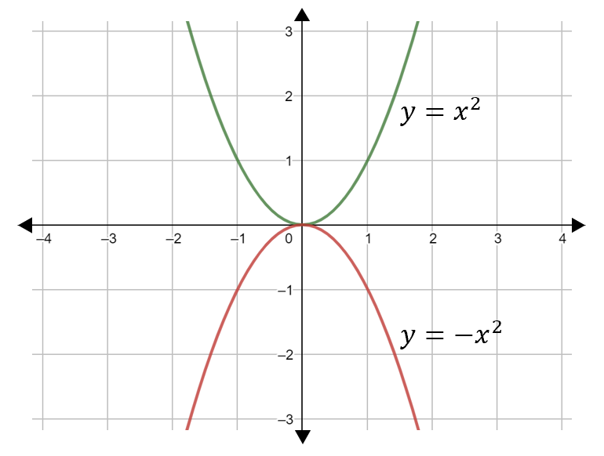
Practice

Slide 30
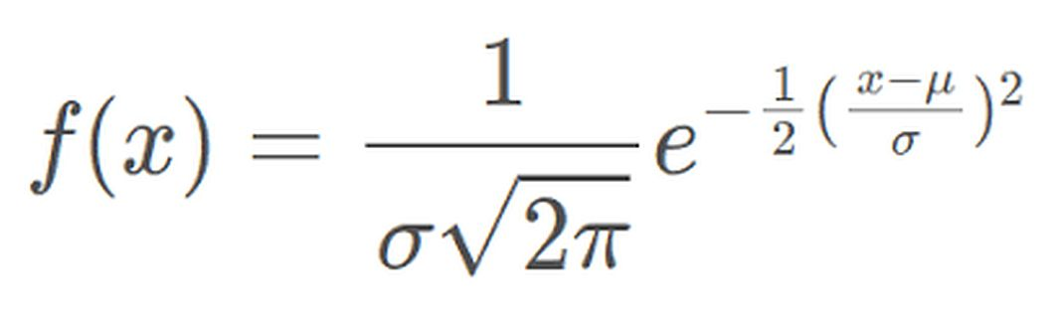
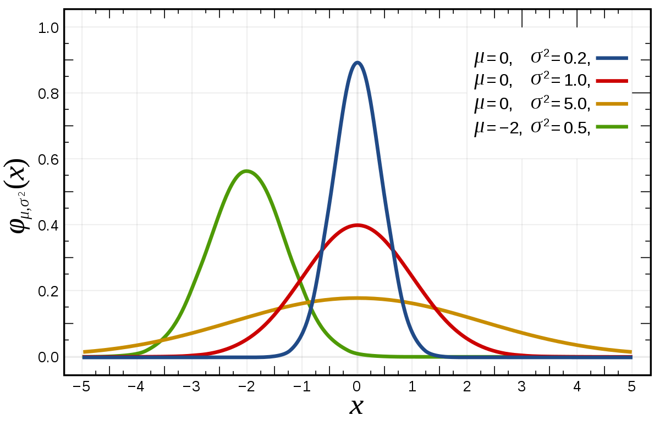
Practice

